Slide 1
DIAGNOSIS OF EYE FUNDUS DISEASE CLASSIFICATION AND SEGMENTATION USING ARTIFICIAL INTELLIGENCE TECHNIQUES Surya Anush M[211420104278] Prashanth S[211420104201] Sai Charan Raj G[211420104235]

Slide 2
ABSTRACT :
Eye fundus diseases are critical conditions that can lead to severe vision impairment and even permanent blindness if not diagnosed and treated promptly. Manual diagnosis of these diseases is time-consuming and heavily reliant on the expertise of ophthalmologists. This research aims to develop an efficient and accurate diagnostic system for eye fundus disease classification and segmentation using artificial intelligence techniques. The study involves the compilation of a comprehensive dataset of eye fundus images, encompassing various types of diseases, including diabetic retinopathy, age-related macular degeneration, glaucoma, and others. Each image is accompanied by corresponding ground-truth annotations provided by expert ophthalmologists for segmentation. The experimental results demonstrate the effectiveness and reliability of the proposed system in accurately classifying eye fundus diseases and segmenting affected regions within the images. The AI models achieve high accuracy and provide valuable insights into the presence and extent of various fundus diseases.
Keywords: Eye Fundus Disease, Artificial Intelligence, Deep Learning, Disease Classification, Segmentation, Convolutional Neural Networks, U-Net, Ophthalmology, Medical Imaging, Diagnostic System.

Slide 3
EXISTING SYSTEM:
Diabetic retinopathy (DR) is a complication of diabetic Mellitus, developing retinal lesions that impair vision. The DR detection in the early stages avoids permanent vision loss. The treatments provide relief, and the vision loss due to DR is irreversible. The manual grading of DR is time-consuming and prone to human errors. The other real-time problem is exchanging patient fundus image information with hospitals worldwide while upholding the organizations’ privacy concerns. When training a deep learning (DL) network, two critical factors to keep in mind are creating a collaborative platform and protecting patient data privacy. Therefore, an automated DR detection technique is required while protecting patient data and privacy. In this work, we propose a novel DR severity grading technique based on Federated Learning (FL), a recent advancement in DL called DRFL. FL is a new research paradigm that allows DL models to be trained collectively without disclosing clinical information. In DRFL, we combined the Federated averaging (FedAvg) technique and the median of the categorical cross-entropy loss. In comparison to FedAvg, the median cross-entropy is better suited for either under-fitted or over-fitted clients. Also, we propose a novel central server that extracts multi-scale features from the fundus images to identify small lesions present in the fundus image.

Slide 4
PROPOSED SYSTEM:
The proposed system aims to develop an advanced diagnostic tool for eye fundus disease classification and segmentation using cutting-edge artificial intelligence techniques. Leveraging the power of deep learning algorithms, the system offers an efficient and accurate solution to assist ophthalmologists in diagnosing and treating various eye fundus diseases promptly. A comprehensive dataset of eye fundus images is collected, comprising diverse cases of different eye fundus diseases, including diabetic retinopathy, age-related macular degeneration, glaucoma, and others. The dataset is annotated by expert ophthalmologists to provide ground-truth segmentation masks for each image. The proposed system employs Convolutional Neural Networks (CNNs) for eye fundus disease classification. The CNN architecture is trained on the pre-processed dataset, enabling it to learn distinctive disease patterns and features from the images. The dataset is split into training, validation, and testing sets. During the training process, both the disease classification CNN and the segmentation U-Net are optimized using back propagation and gradient descent techniques to minimize the loss and maximize accuracy.

Slide 5
ADVANTAGES
We classify the disease and segmented.
We build a production level application for deployment purposes.
Huge amount data above 5000 images.
Findout 4 classification.
DISADVANTAGES
Focused on only classification.
They did not done a deployment.
Low efficient margin images.
Focused on only one disease

Slide 6
ENVIRONMENT REQUIREMENTS:
1. Software Requirements:
Operating System : Windows
Tool : Anaconda with Jupyter Notebook
2. Hardware requirements:
Processor : Intel® Core™ i7 processor 14650HX (30M Cache, up to 5.20 GHz)
Hard disk : minimum 80 GB
RAM : minimum 4 GB

Slide 7
MODULE DESCRIPTION
IMPORT THE GIVEN IMAGE FROM DATASET
We have to import our data set using keras preprocessing image data generator function also we create size, rescale, range, zoom range, horizontal flip. Then we import our image dataset from folder through the data generator function. Here we set train, test, and validation also we set target size, batch size and class-mode from this function we have to train using our own created network by adding layers of CNN .

Slide 8
Convolutional layers
Convolutional layers are the layers where filters are applied to the original image, or to other feature maps in a deep CNN. This is where most of the user-specified parameters are in the network. The most important parameters are the number of kernels and the size of the kernels.
Pooling layers
Pooling layers are similar to convolutional layers, but they perform a specific function such as max pooling, which takes the maximum value in a certain filter region, or average pooling, which takes the average value in filter region. These are typically used to reduce the dimensionality of the network.

Slide 9
Artificial Neural Networks
Artificial Neural Networks contain artificial neurons which are called units. These units are arranged in a series of layers that together constitute the whole Artificial Neural Network in a system. A layer can have only a dozen units or millions of units as this depends on how the complex neural networks will be required to learn the hidden patterns in the dataset. Commonly, Artificial Neural Network has an input layer, an output layer as well as hidden layers. The input layer receives data from the outside world which the neural network needs to analyze or learn about.

Slide 10
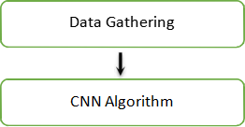
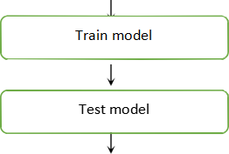

Construction of a Detecting Model
Deep learning needs data gathering have lot of past image data’s.
Training and testing this model working and predicting correctly
.

Slide 11
SOFTWARE DESCRIPTION
Anaconda is a free and open-source distribution of the Python and R programming languages for scientific computing (data science, machine learning applications, large-scale data processing, predictive analytics, etc.), that aims to simplify package management and deployment. Package versions are managed by the package management system “Conda”.
ANACONDA NAVIGATOR
Anaconda Navigator is a desktop graphical user interface (GUI) included in Anaconda® distribution that allows you to launch applications and easily manage conda packages, environments, and channels without using command lines.

Slide 12
JUPYTER NOTEBOOK
This website acts as “meta” documentation for the Jupyter ecosystem. It has a collection of resources to navigate the tools and communities in this ecosystem, and to help you get started.
Visual Studio Code
Visual Studio Code (VS Code) is a versatile and lightweight source code editor that provides a wide range of features for developers. It supports various programming languages and extensions, making it a popular choice for Python development and beyond.

Slide 13

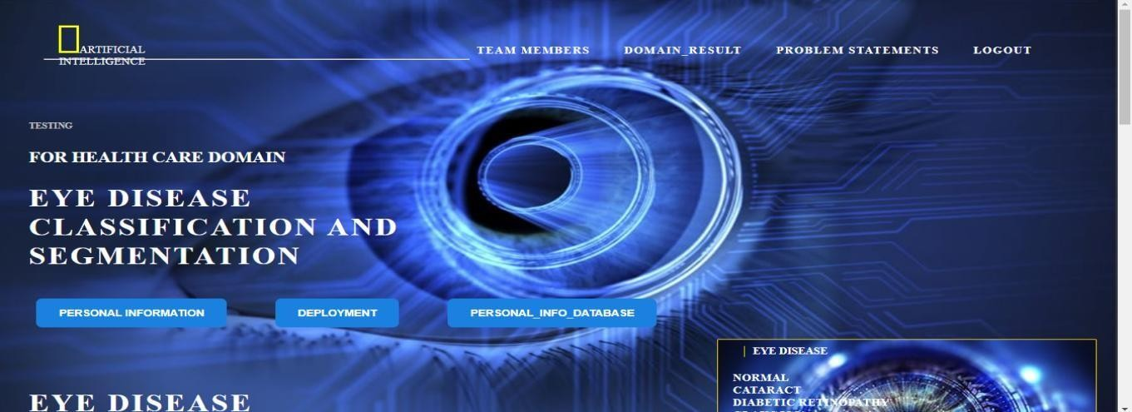
OUTPUT

Slide 14
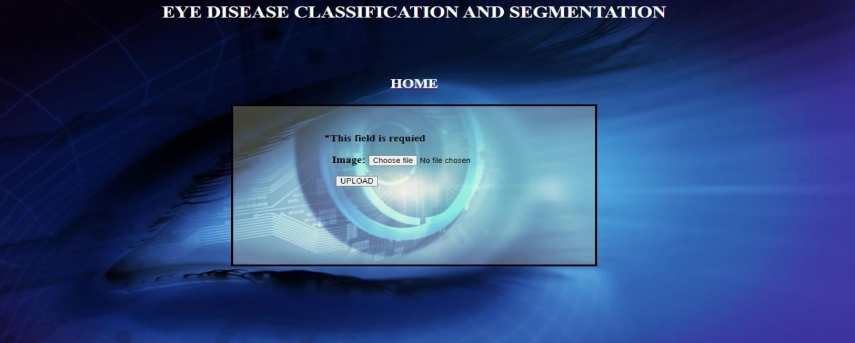
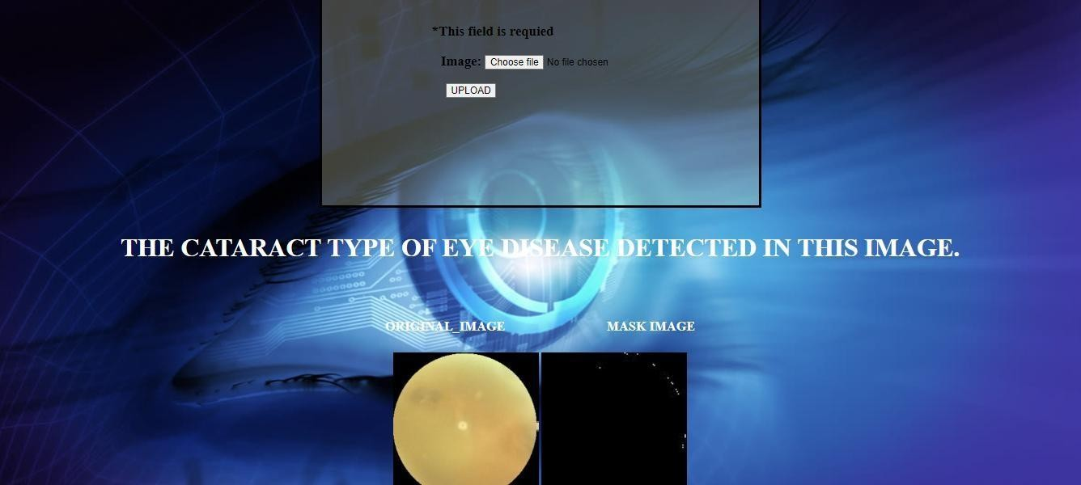

Slide 15
THANK YOU

